Slide 1
Sales Forecast
Jose Luiz Mattos Gomes
CSIS4260 - Nikhil Bhardwaj

Slide 2

Agenda
Motivation
Case Study
Methodology
Algorithms
Findings
Conclusion

Slide 3

Motivation
Forecasting
Means estimation of quantity, type and quality of future work e.g. Sales.
It helps in guiding marketing, production and other business activities for achieving these targets.
Sales forecasting is a commitment of the sales department of all companies.
Notes:
Every company that sells something needs to estimate its sales so it can plan its budget, define its marketing plan, whether its production and inventory capacity are adequate, whether its suppliers can deliver the goods in time for the demand, etc.
My project is a tool to help them forecast their sales.
Based on sales history and a set of variables that may affect these sales, the tool chooses the best statistical method and identify which variables are relevant to the model.

Slide 4
Case Study
Kaggle - Walmart Recruiting - Store Sales Forecasting
45 Walmart stores located in different regions. Each store contains several departments.
The sales historical data covers from 2010-02-05 to 2012-11-01.
Additional Data – Independent Variables
Temperature | Average temperature in the region
Fuel Price | Cost of fuel in the region
MarkDown 1-5 | Anonymized data related to promotional markdowns that Walmart is running
CPI | The consumer price index
Unemployment | The unemployment rate
IsHoliday | Whether the week is a special holiday week
Notes:
For this simulation, I am using a dataset from Walmart at Kaggle.
It has 45 stores from different regions and each store has several numbers of departments.
The sales historical data covers about 2 and a half years.

Slide 5
Case Study – Data Structure
3331 Stores/Departments Most (2660) have 143 weeks of data
45 Stores
Notes:
About the data:
Not all 45 stores have the same number of departments.
And not all departments have the same quantity of data (number of weeks).

Slide 6
Case Study – Independent Variables
Notes:
The independent variables:
Those are pictures to illustrate how those variables are distributed through the time series.
The shapes are completely different between them from each store.

Slide 7
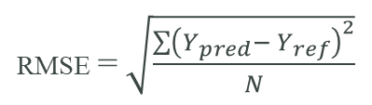
Methodology
Data
Independent Variables
Best Method
Lowest RMSE (Root Mean Square Error)
2$1/2$ years historic data
21⁄2 years historic data
80% Training
Simple Mean
Holts Linear
Linear Regression
Exponential Smoothing
ARIMA
Moving Averages
CPI
Fuel Price
Holiday
Temperature
Unemployment
Algorithms
Markdowns
20% Test
RMSE = $\sqrt{\frac{{\sum{\left(Y_{pred}− Y_{ref}\right)}}^{2}}{N}}$
Notes:
First I identified how much historical data was available and divided it into training and test data tables, then I loaded the independent data. The next step was to go through each store and then each department, run the statistical algorithms, and save the results. The final step was to choose the best method for each data set. For that, I used the Root Mean Square Error.
The best method is the one with the lowest RMSE.
ARIMA stands for Autoregressive Integrated Moving Average. it uses a combination of autoregressive (AR), integration (I), and moving average (MA) operations.

Slide 8
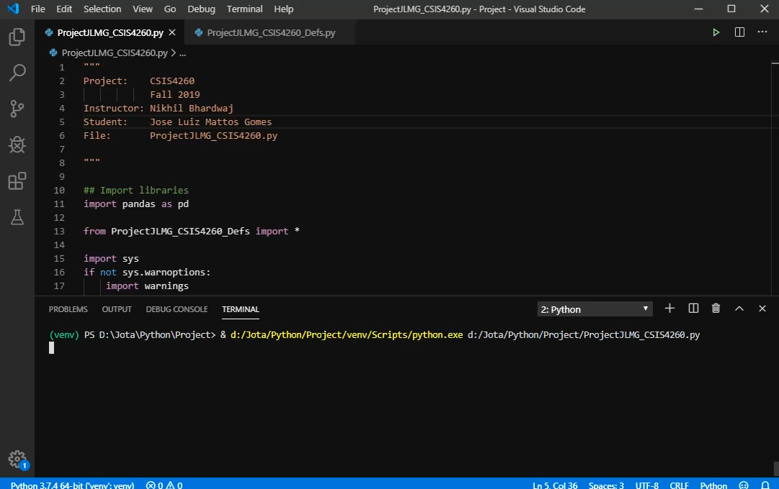
Algorithms
Notes:
I am not going to run a demo, because it takes more than one hour to run and collect all the data, so I am just showing this video to prove that the code is in python and it is running.

Slide 9
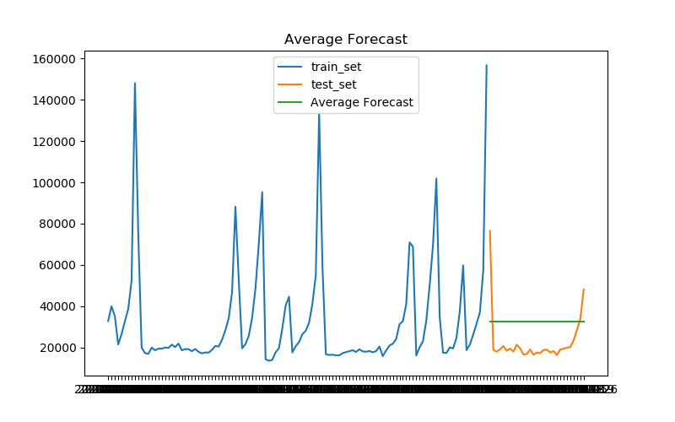
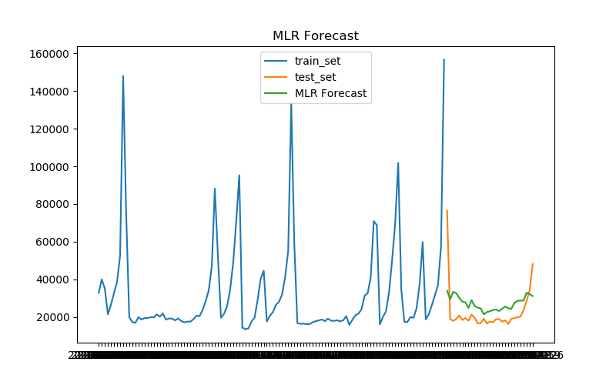
Algorithms
Chosen Method
Algorithms Results Store 14 / Department 1
Notes:
Here it is a sample of the resulting data from the algorithms for one department of one store.
The method chosen here was linear regression.

Slide 10
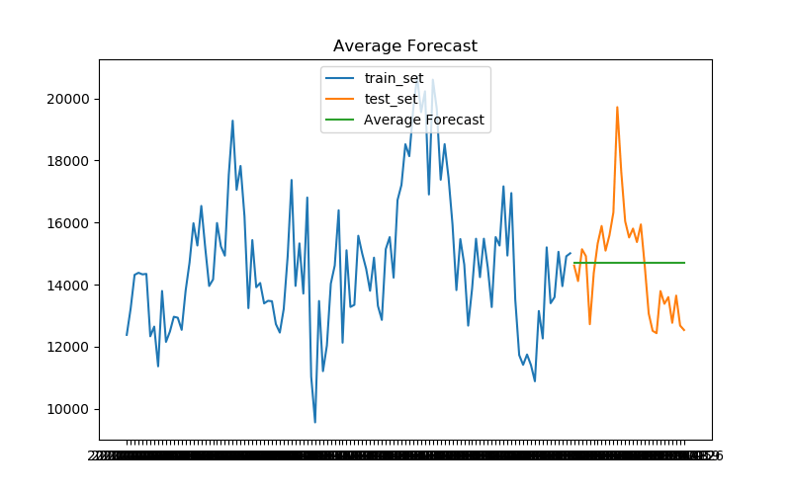
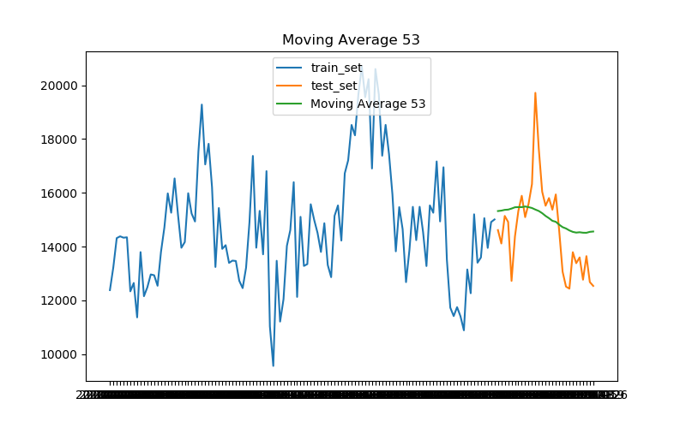
Algorithms
Chosen Method
Algorithms Results Store 21 / Department 10
Notes:
In this other example, the method chosen was the 12-month moving average

Slide 11
Findings - Models
Notes:
Here it is possible to see how the methods were distributed throughout the main dataset and in detail can be analyzed by store or by department.
Multilinear regression was the winning method considering all the data together.
When looking by Store or by Department, the variance is high and some methods work better for one set of data and other methods for others, as expected.

Slide 12
Findings – Independent Variables
Notes:
Observing the independent variables, the temperature was the main factor that affected sales.
Other external factors, such as the price of fuel and the consumer price index, were also found to be relevant variables.
Two of the three internal factors (Markdowns) were the most significant.
The holidays were not significant.
Looking at the details by store or department, the significant independent variables vary, but the temperature is often the main factor.

Slide 13
Conclusions
About the analyzed data and statistical methods used
Multilinear regression was the most assertive method.
ARIMA and exponential smoothing did not perform well. Parameter setting may be the main cause.
The Temperature was the main variable that influences the analyzed data. Information from MarkDown 2 and 3, Fuel Price and CPI also had a major influence on sales.
Notes:
ARIMA stands for Autoregressive Integrated Moving Average
use a combination of autoregressive (AR), integration (I), and moving average (MA) operations

Slide 14
Conclusions
About the Project
The tool was able to analyze the data series and choose the best statistical method for sales forecast based on root mean square error.
It was also possible to identify the independent variables that most affect the model and those that do not.
Independent variables and other parts of the algorithms are hardcoded, but with adjustments and improvements, the tool can become flexible and accept any set of independent variables.

Slide 15
Thank You

